Slide 1
City Manager Directed Parking Group
May 8, 2024

Slide 2
Purpose – To prepare a list of recommendations for the CM regarding immediate parking strategies prior to the the establishment of a permanent Ordinance-driven Parking Commission.
Topics for Discussion
Extent and location of monetization and permit areas
Hourly rates and times of enforcement
Type(s) of payment methods (kiosk, pay-by-plate, etc.)
Annual permit rates, location, and number of spots
Parking fine increase and frequent offender penalties
Winter Parking needs
Timeframe of implementation
Creation of Parking Fund
Additional enforcement needs
Additional topics as required

Slide 3
Some Considerations
Closure of Union St. Lot
60 Wakefield lease – Additional 111 spaces
Lease-up of The Howard (45 units)
Lease-up of 77 North Main (5 units)
The Howard – 1 or 2 new commercial spaces
Bennett Building – 1 or 2 new commercial spaces
Redevelopment of 38 Hanson St (1-2 commercial)
1 Wakefield new commercial lease-up
10 North Main commercial rental
22 South Main – commercial lease-up (July ’24)
FY24/25 CIP for parking ($148,000)

Slide 4
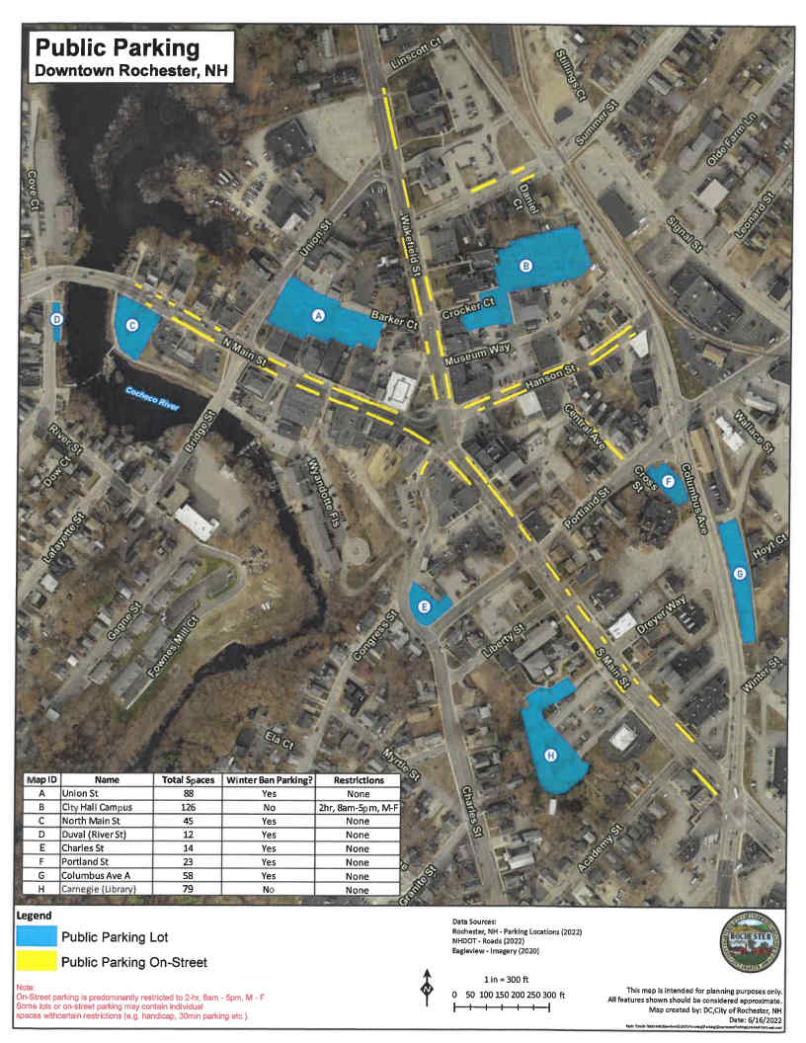
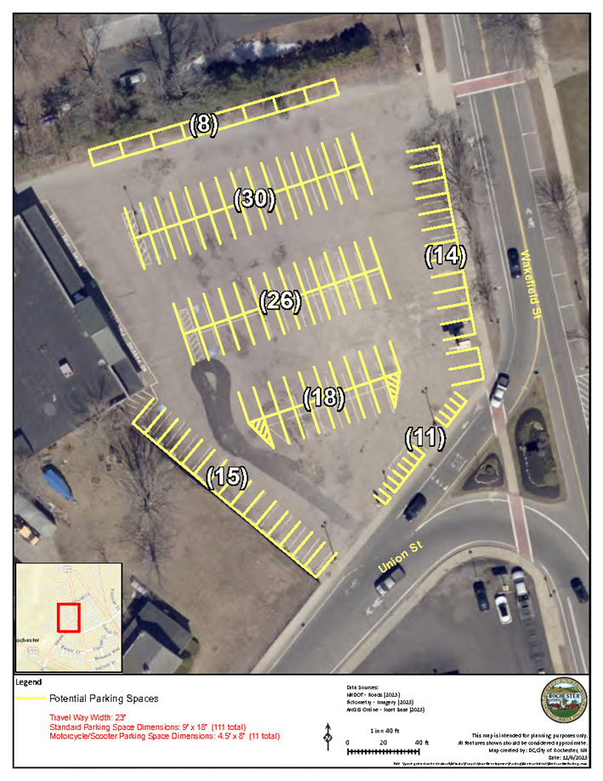
All Public Spaces
60 Wakefield

Slide 5
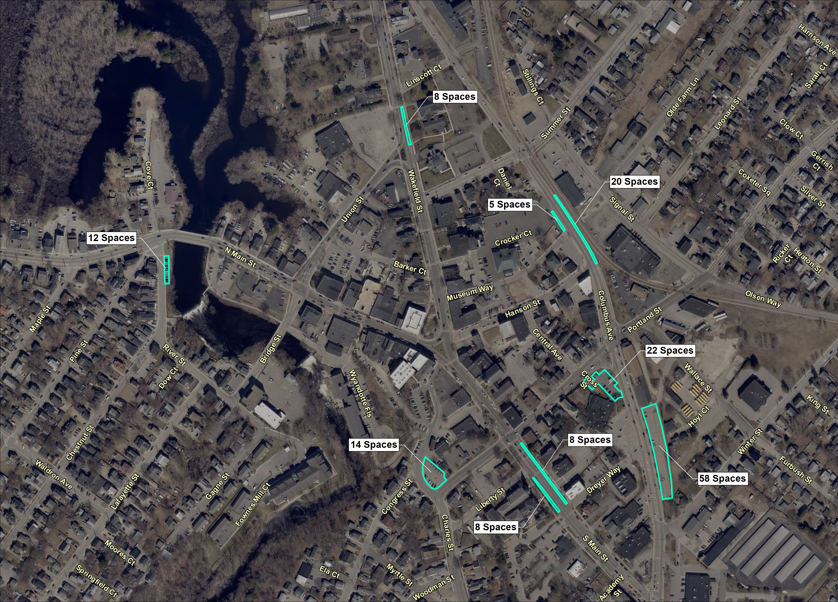
Draft Permit Parking Locations
Total – 155
+60 Wakefield St.
37 Spaces
Overall = 192

Slide 6
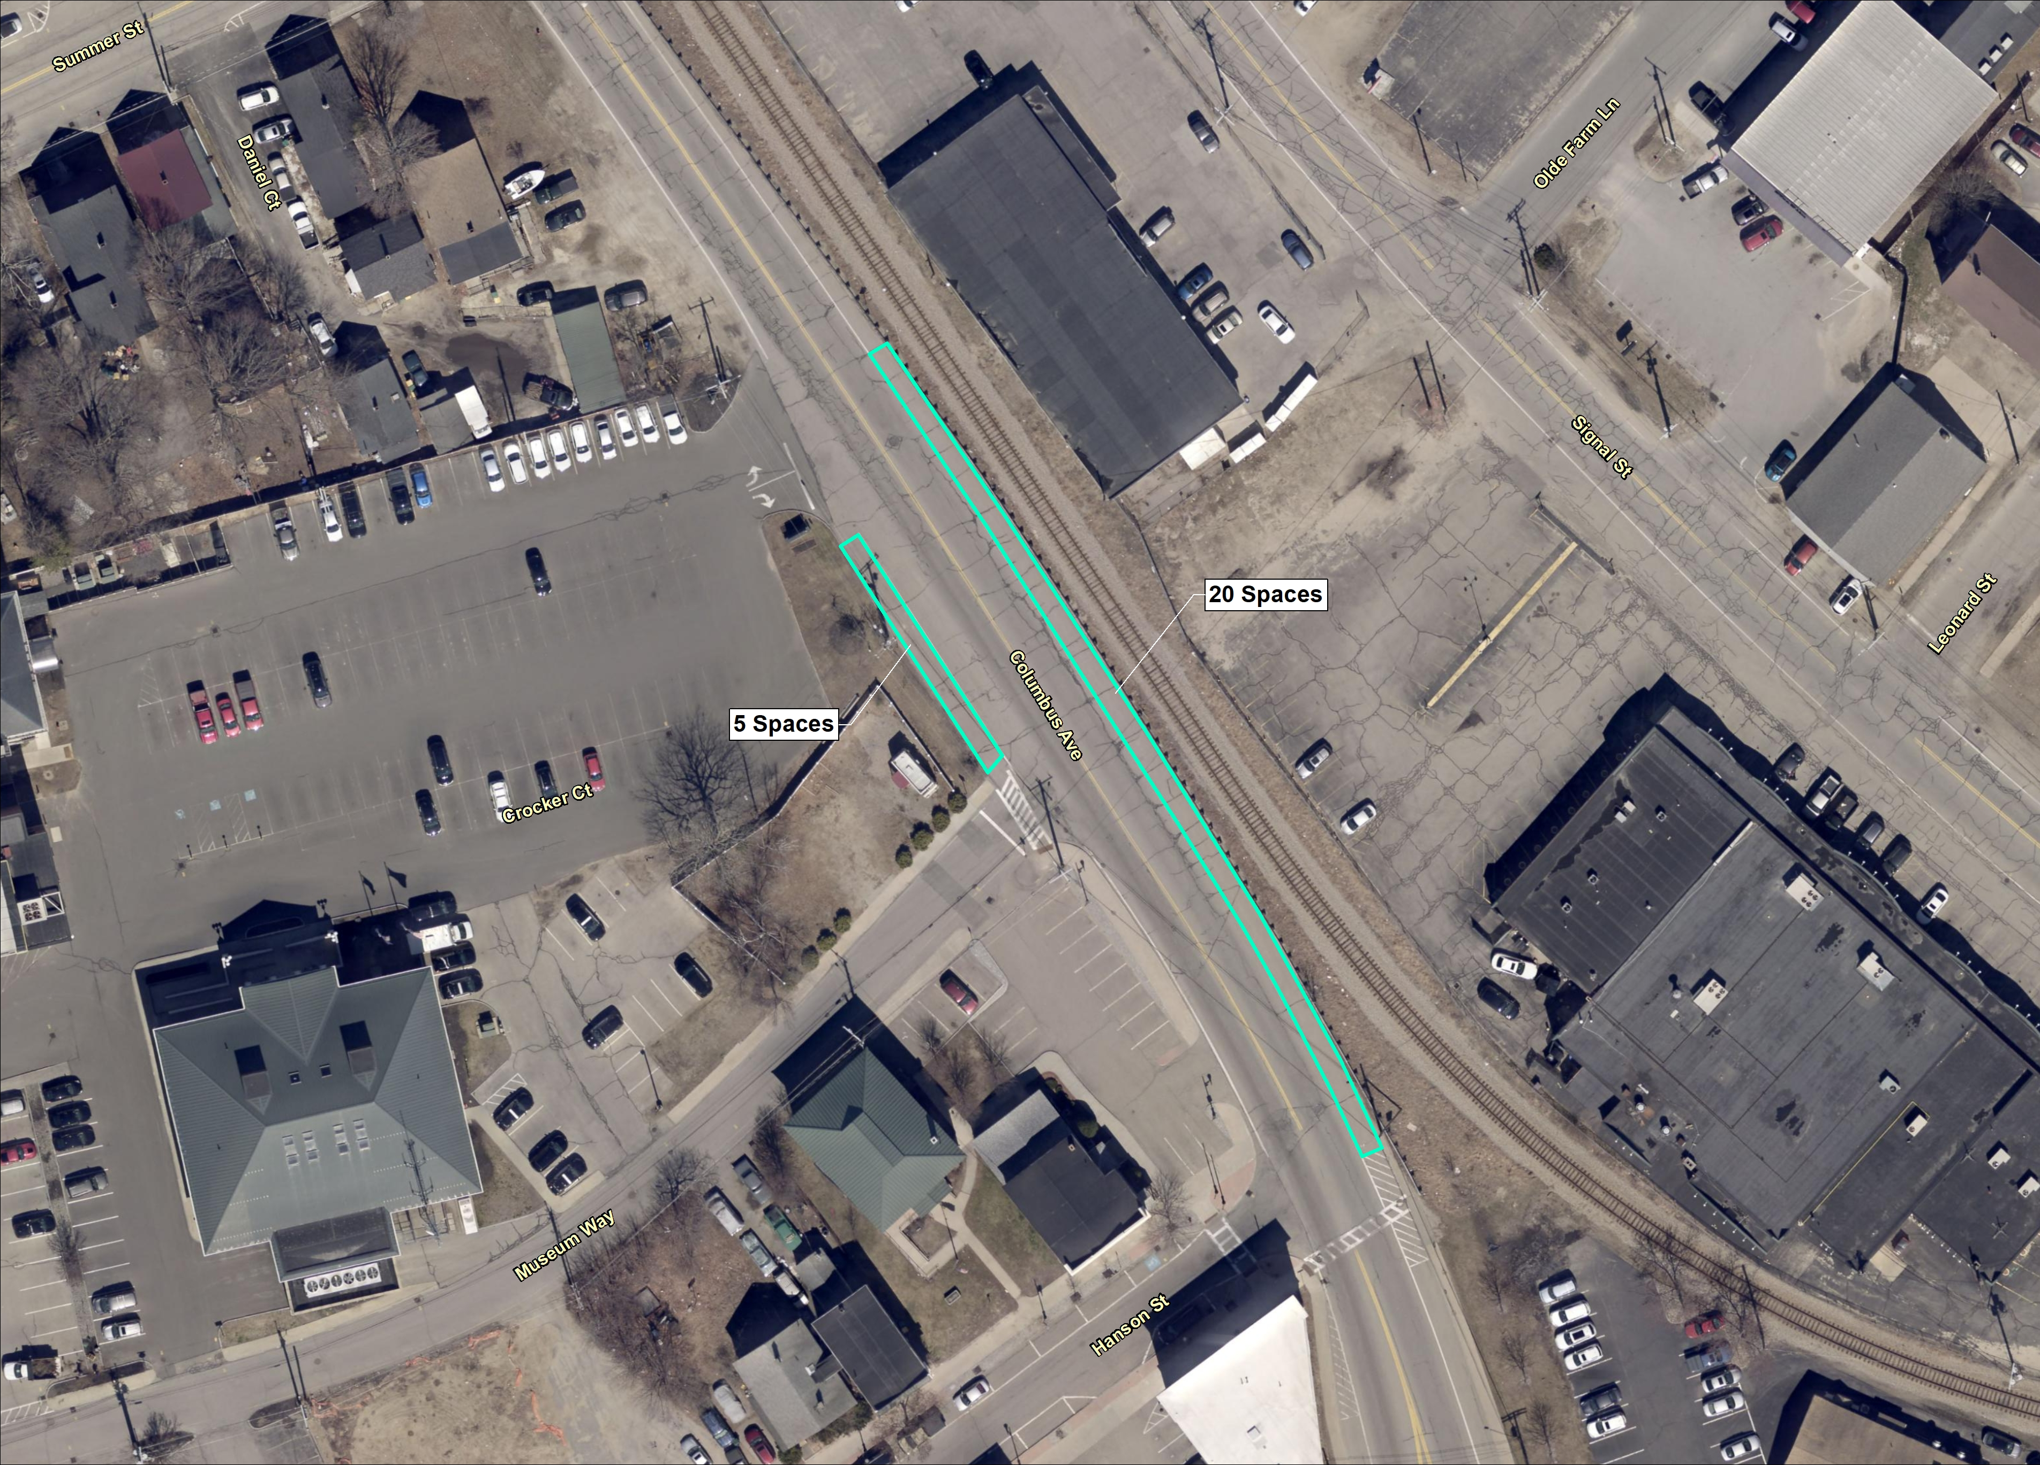
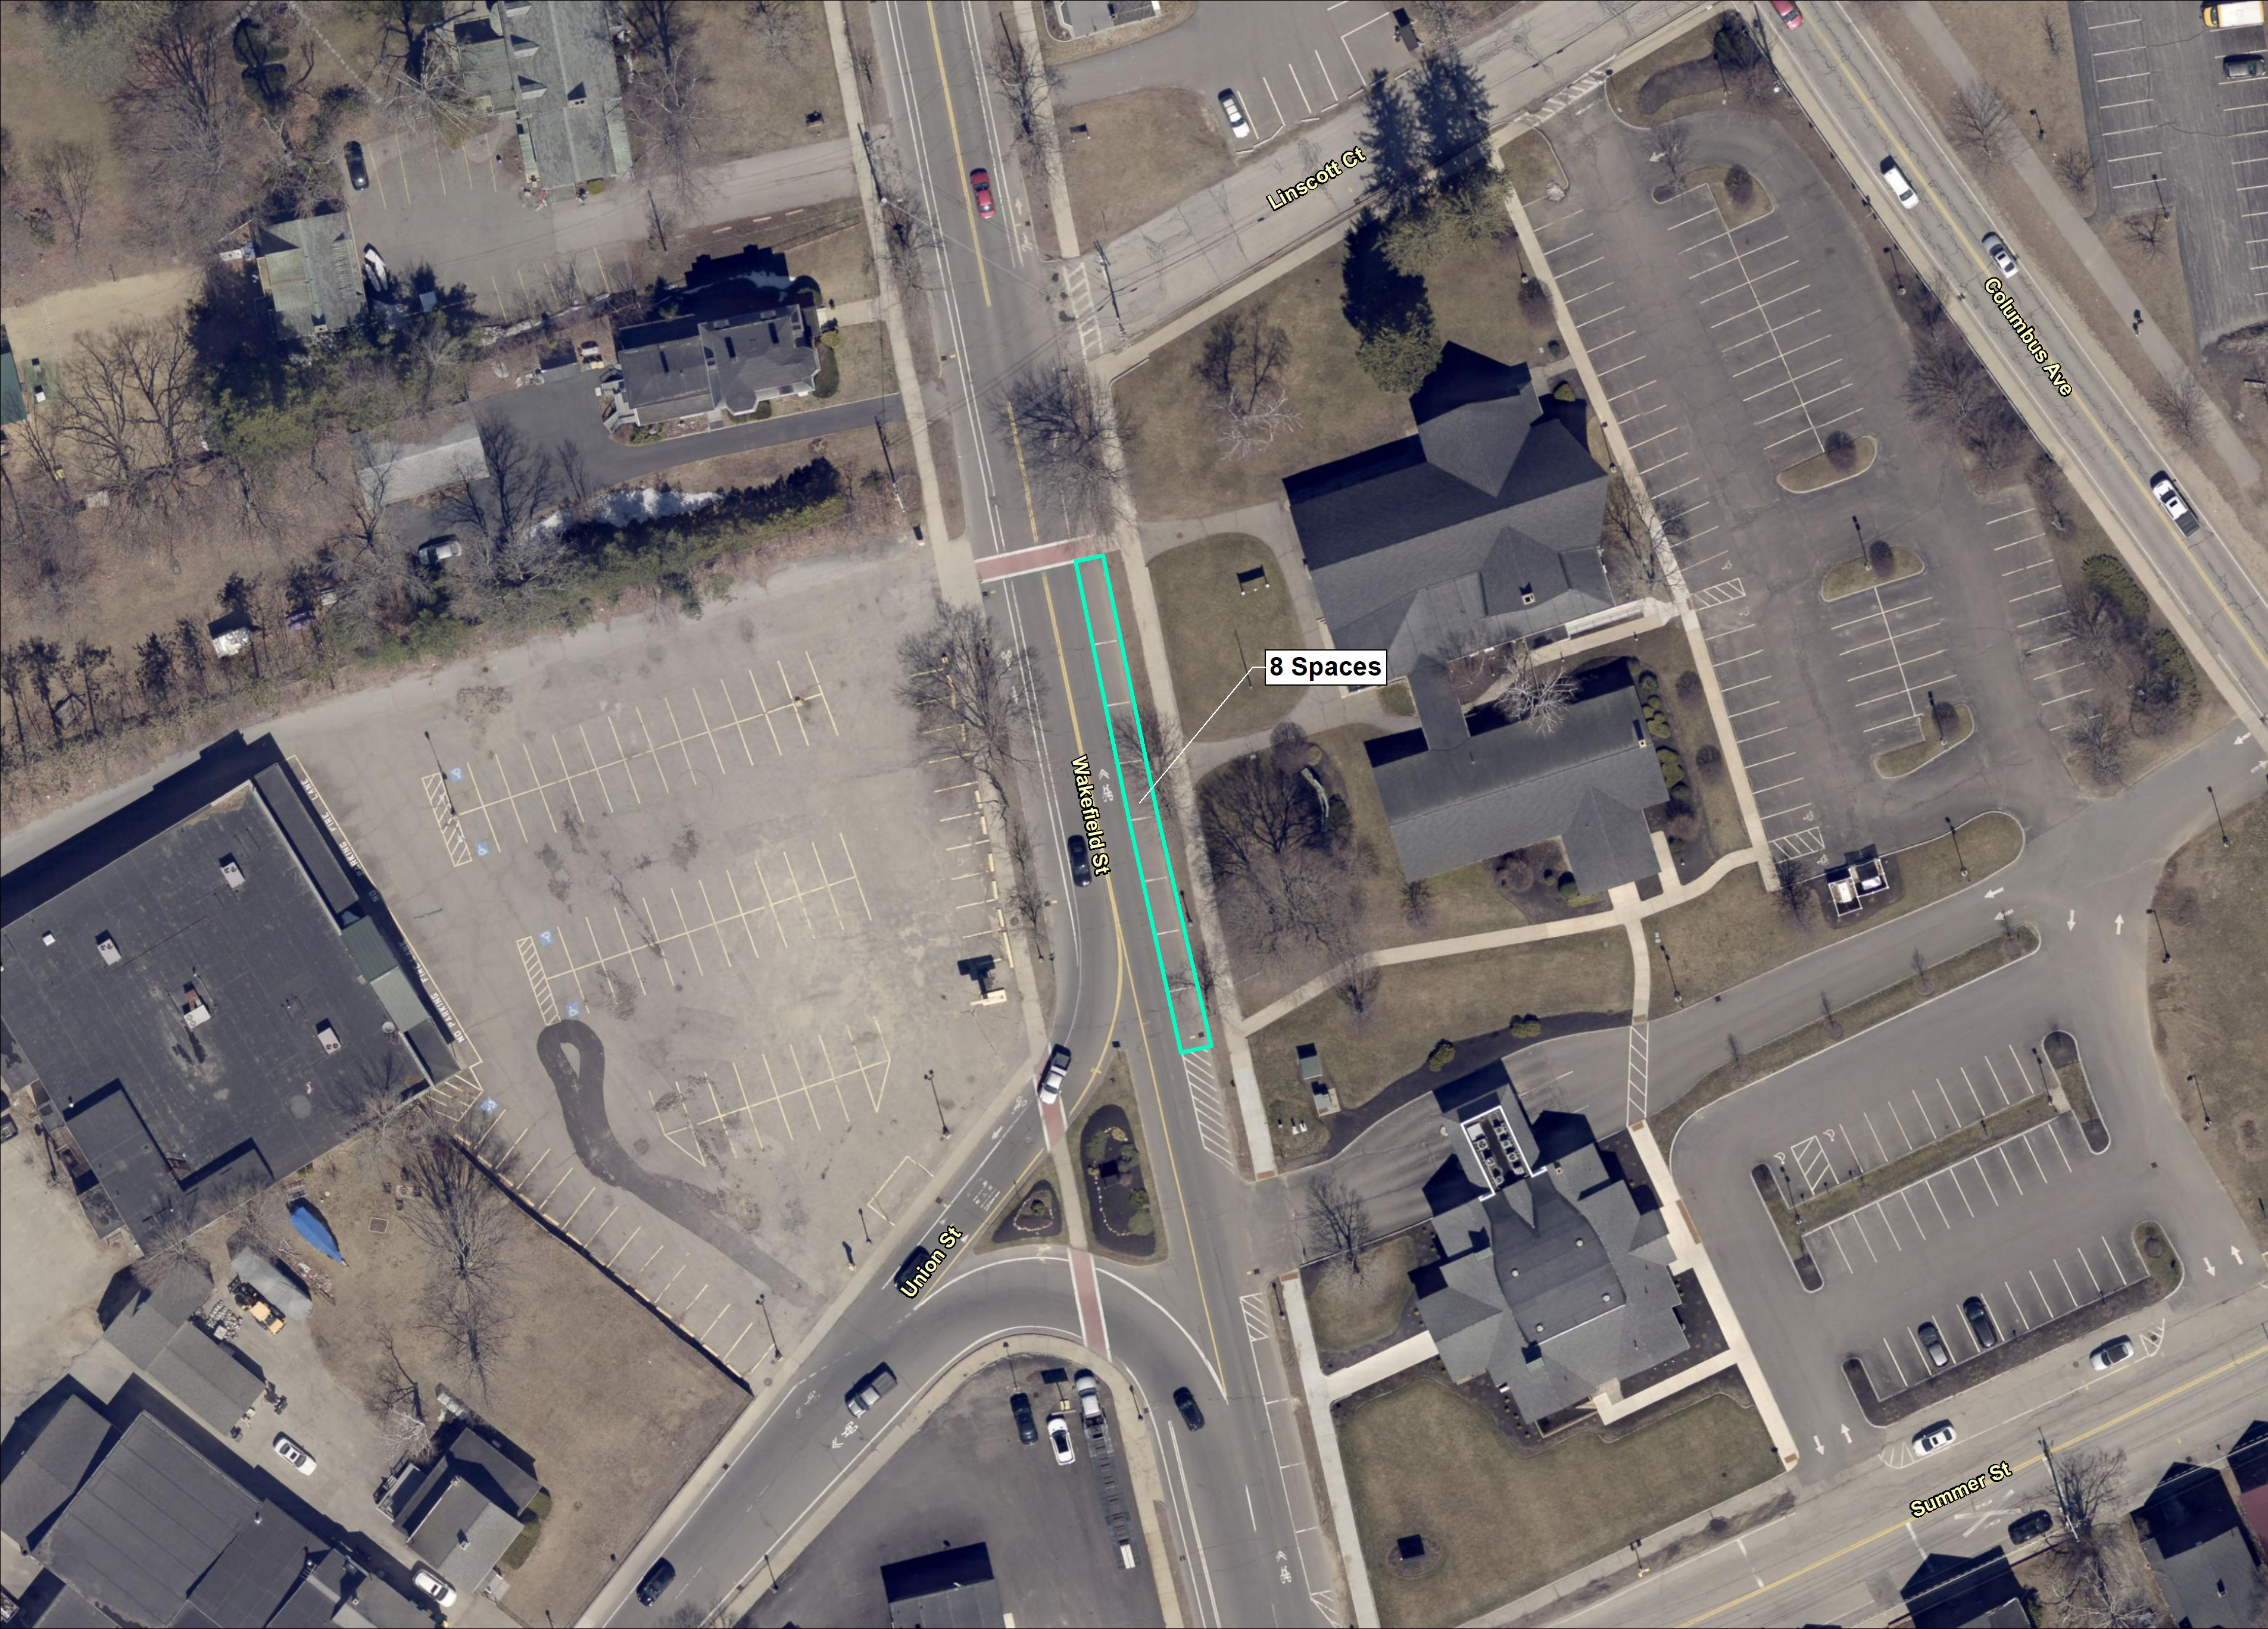
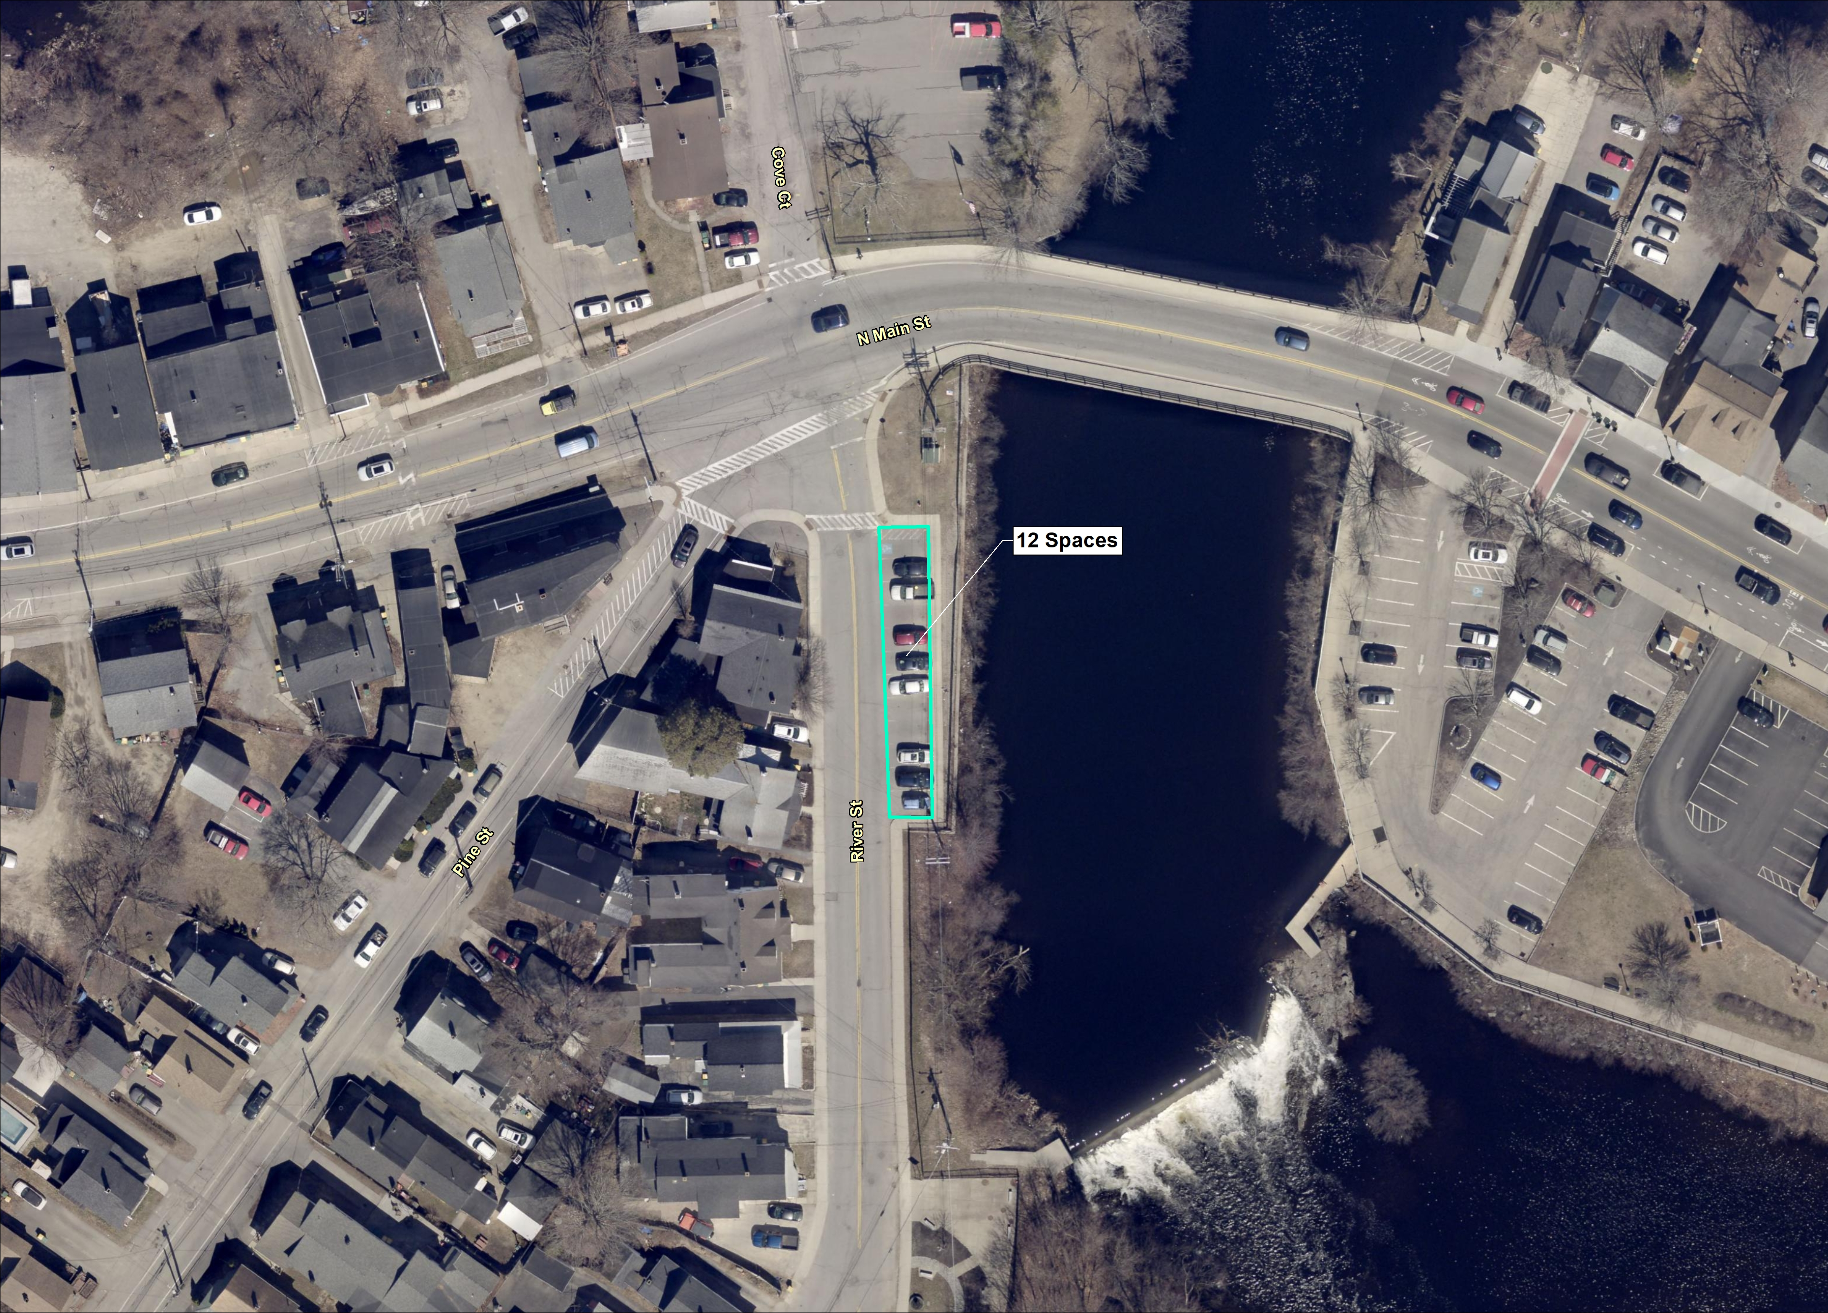
Columbus Ave./ Hanson St.
25 spaces (est.)
Wakefield St.
8 spaces
River St.
12 spaces

Slide 7
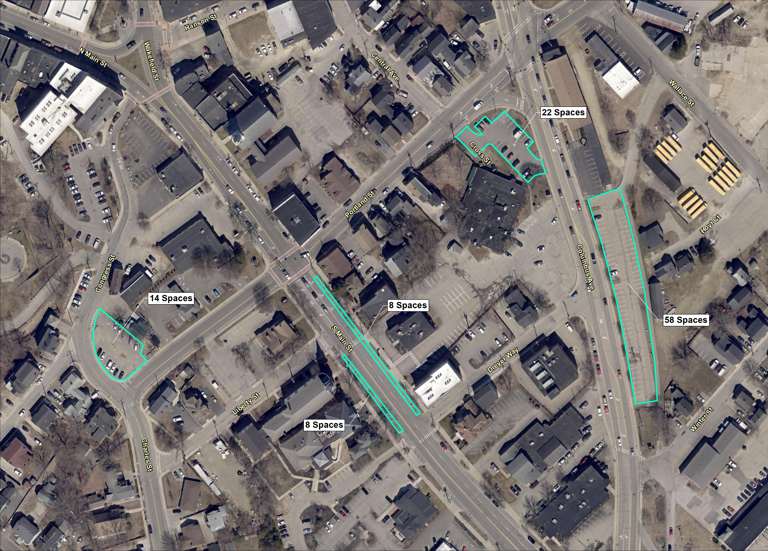
Portland St. / Columbus
22 spaces
Columbus Ave. (B)
58 spaces
Congress St.
14 Spaces
South Main St.
16 Spaces

