Slide 1
New Hampshire’s Newest Lottery Game

Slide 2
What is KENO 603?
KENO 603 is rapid draw numbers game
20 winning numbers drawn by Random Number Generator (RNG), every 5 minutes from 11 AM to 11 PM
Currently approved to be sold in “pouring establishments” in NH, if passed by local municipality

Slide 3
How to Play KENO
Minimum play = $1
Select up to 12 spots (numbers) from a field of 80 on a play slip, or use Easy Pick to have the Lottery terminal select your numbers
20 winning numbers randomly chosen for each drawing
Winning numbers are displayed on the monitor
Players win based on how many of the winning numbers they match to the ones randomly chosen
Drawings held 7 days/week, every 5 minutes from 11 am – 11 pm

Slide 4
KENO PLUS Option
KENO PLUS gives you a chance to increase your KENO 603 winnings by 3, 4, 5 or 10 times.
To play KENO PLUS, mark the “KENO PLUS” box on your play slip. The cost of your wager will double. KENO PLUS cannot be played separately.
If you purchase the additional KENO PLUS for a drawing and win, multiply your winnings if a multiplier number (3, 4, 5 or 10) is drawn. KENO 603 PLUS not available for the 10, 11, or 12 Spot Games.

Slide 5
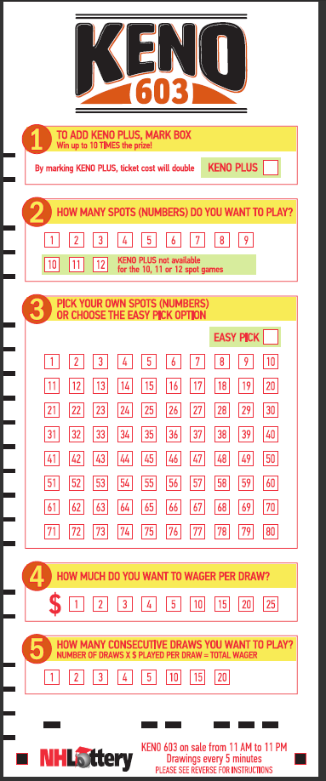
Using the Playslip
Add KENO PLUS by marking the box – the ticket cost will double
Place your wager – how much you would like to play per draw
($1 - $5, $10, $15, $20, $25)
1
4
Choose your spots – how many spots (numbers) per game to play (1-12)
2
Consecutive Draws – Indicate how many games in a row you wish to play (multiply your wager x number of draws for total wager)
5
Pick your numbers – mark as many spots as you chose to play in step 2 or mark EASY PICK and let the computer choose for you
3

Slide 6
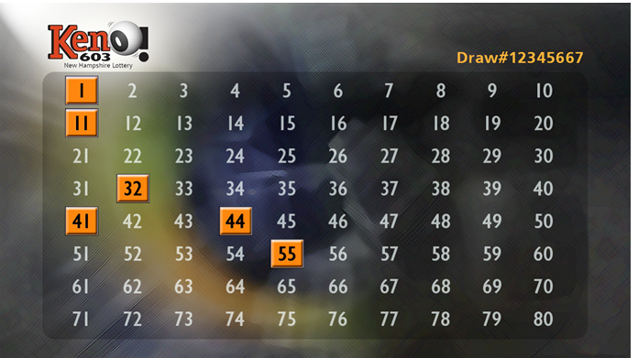
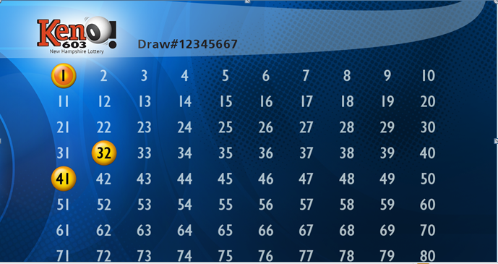
Monitor Screens
Sample Drawing Screens (concepts only)

Slide 7
Who Can Offer KENO 603
Establishments holding a valid liquor license under RSA 178:20, II, RSA 178:21, II(a) or (b), or RSA 178:22 (“pouring establishment”)
Principal owner(s) subject to criminal background check
Final approval to sell KENO 603 is subject to NH laws and NH Lottery Commission rules and regulations
$500 annual licensing fee
Each city and town must pass KENO locally in order for establishments to sell.

Slide 8
What KENO 603 Can Do For You
Increase foot traffic in establishment
Increase sales and check average from additional winnings spent on food, beverages, and tips for staff
Earn selling & cashing commission
Earn selling bonuses

Slide 9
Commission/Selling Bonus
Establishments earn 8% commission on every dollar sold for the KENO 603 game. That’s the highest commission for Keno in the US!
Earn a bonus for selling a KENO 603 prize of $10,000 and greater equal to 1% of the prize capped at $75,000.
For other lottery products, retailers receive 5% commission on every dollar sold, along with a 1% cashing bonus on scratch tickets, Fast Play, and Pick 3 and Pick 4, as well as a bonus of 1% on selling prizes of $10,000 and greater (capped at $75,000, not applicable for scratch tickets).
Establishments that sell Keno in other states report an increase in food and beverage sales from customers staying longer to play Keno.

Slide 10
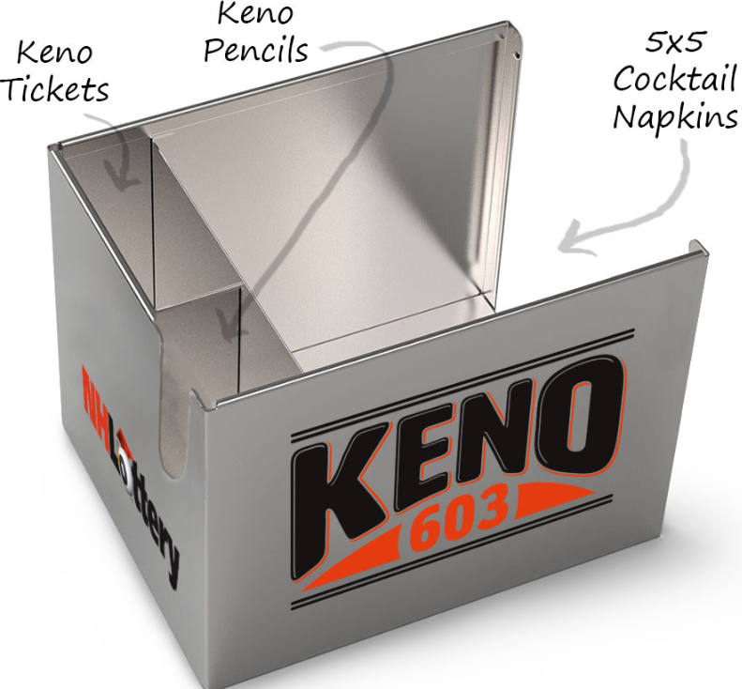
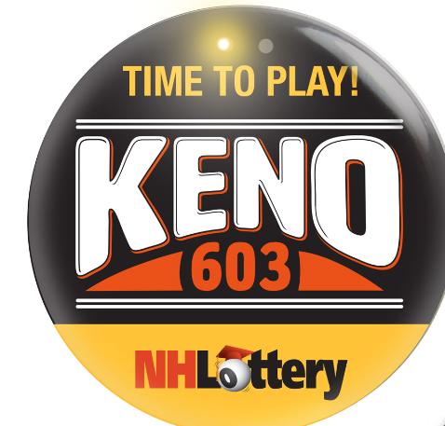
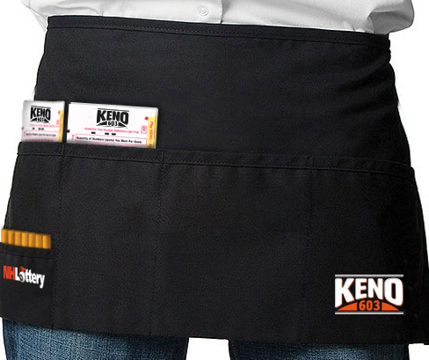
Advertising/Point-of-Sale Examples (Provided Free of Charge)
TV
Radio
Online
Posters
Buttons and aprons
Play slip caddies
Signage

Slide 11
Thank You!

